Slide 1



Short-form Media’s Impact on Short-term Memory
Presented by Jerry Xiao - Stephen F. Austin High School​

Slide 2

Overview
Intro
Methodology
Literature Review
Result/Data
Research Gap
Discussion/Conclusion
Research Question
Limitations/Future

Slide 3
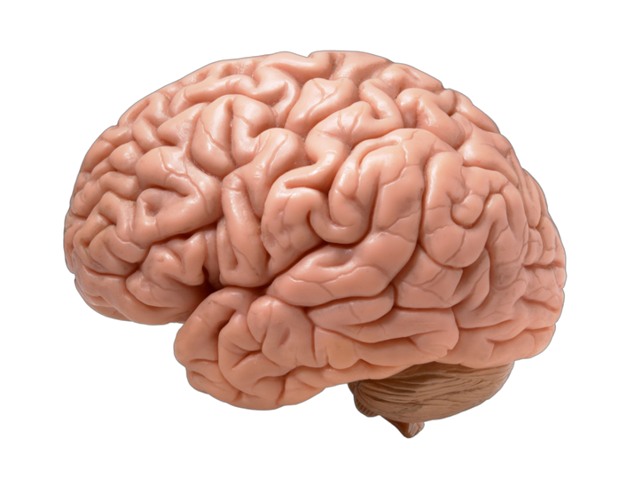



Introduction/Background
Short-form media, characterized by short, engaging digital content (under 1 minute), rapidly expanding on platforms like TikTok, Instagram Reels, YouTube Shorts.
Increasing multitasking behaviors raise concerns regarding cognitive processes and academic performance in adolescents.
Prior studies suggest media multitasking negatively affects memory encoding and recall, creating potential academic disruptions (Nelson & Miller, 2020; Uncapher et al., 2015)​

Slide 4
Literature Review
Multitasking reduces attention and impairs memory due to cognitive overload (Cain et al., 2016; Ophir et al., 2009).
Short-form media negatively impact memory consolidation, especially when media consumption interrupts studying (Chiossi et al., 2023; Mendoza et al., 2018).
Emotional interference from social media use correlates with memory failures (Sharifian & Zahodne, 2020; Pellegrino et al., 2022)

Slide 5
Gap
Lack of direct studies isolating short-term memory effects from acute short-form video exposure in adolescents.
Insufficient research on how brief, algorithm-driven video content specifically impacts immediate memory encoding (Chiossi et al., 2023).
Few empirical studies directly link personalized short-form media multitasking with academic recall performance​

Slide 6

Research Question/Hypothesis
Participants exposed to short-form social media content will perform significantly worse on short-term memory tasks compared to those not exposed​
How does brief short-form social media exposure impact short-term memory performance in adolescents?

Slide 7
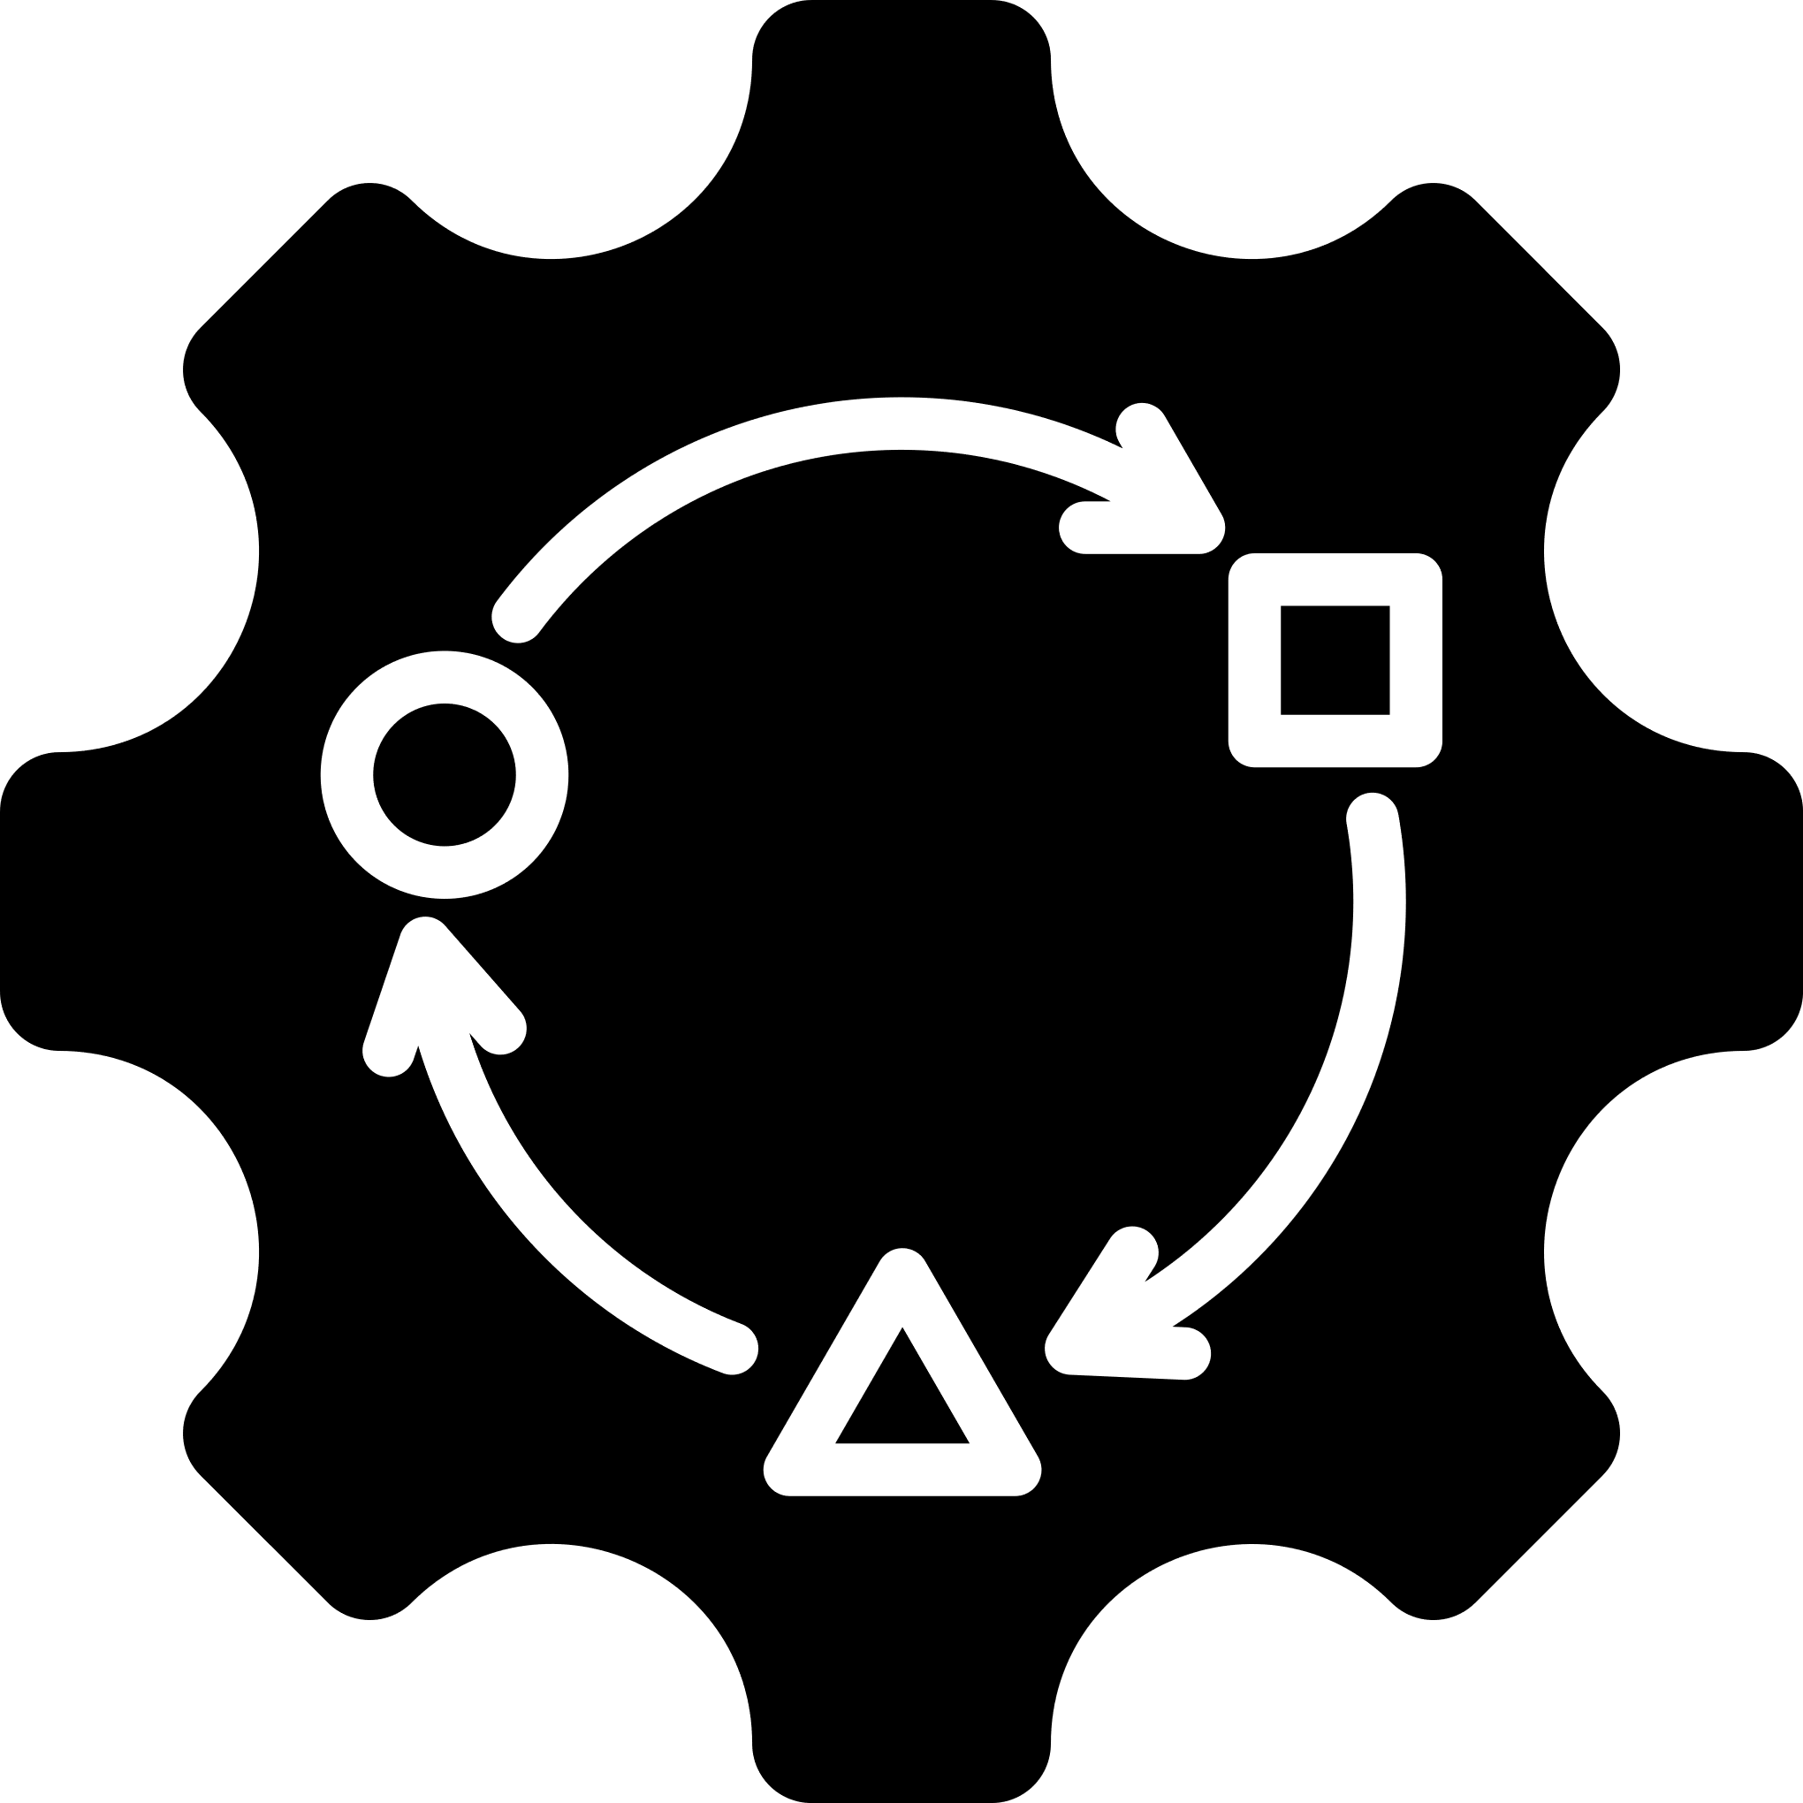

Methodology
Quasi experimental within-subjects design: Each participant experienced all experimental conditions, reducing individual variability and improving internal validity (Cain et al., 2016; Ophir et al., 2009).
The within-subject design better isolates cognitive impacts by ensuring each participant serves as their own control, minimizing extraneous variability. This design is critical for precisely determining the effects of short-form media exposure on short-term memory.

Slide 8




Methodology
Participants experienced three controlled conditions to assess direct effects of short-form media:
Control (No Distraction): measurement w/o media influence.
Intermittent Distraction: Studying → short-form videos → test
Simultaneous Distraction: Studying while simultaneously interacting with short-form videos to evaluate the immediate cognitive impacts of multitasking (Chiossi et al., 2023; Mendoza et al., 2018).
Notes:
Immediate recall directly measures short-term memory capacity and precisely captures the immediate cognitive impact of media exposure, without allowing potential memory consolidation or longer-term retrieval processes to affect outcomes

Slide 9
Methodology
Environment:
One-on-one testing in a quiet, distraction-free private room
Supervision by me throughout each session
Standardized instructions and materials for all sessions
Notes:
Standardizing these conditions ensures that observed differences in memory recall are attributable solely to the manipulated independent variable (short-form media multitasking), eliminating potential confounding influences.

Slide 10
Methodology
10 high school seniors (ages 16–18) from Stephen F. Austin High School, selected based on regular short-form media usage (TikTok, Instagram Reels, YouTube Shorts).
Standardized 20-word recall task (Toronto Word Pool) utilized.
Participants studied words under each experimental condition.
Three-minute interval between studying and recall testing across all conditions.
Materials
Word List Recall Test: Three randomized, 20-word lists composed of neutral, concrete, emotionally neutral words appropriate for high school students
Participant’s personal device/feed
Headphones to standardize sound exposure
Stopwatch for timing each segment
Answer sheets and scoring form
Notes:
Adolescents are particularly susceptible to cognitive distractions from short-form media and represent the age group most engaged with these platforms (Cain et al., 2016; Sharifian & Zahodne, 2020).
(a) word frequency, length, and imagability were matched across lists; (b) items carried minimal emotional valence, preventing affect-based recall advantages; and (c) materials remain comparable with prior media-multitasking studies (e.g., Cain et al., 2016; Nelson & Miller, 2020)
A list of 20 words would be optimal as this number provides a good balance: it is challenging enough to accurately measure memory retention differences yet remains manageable and practical for participants to recall within your testing time (typically about 3-5 minutes for recall). Previous scholarly research often uses around 20–30 words to assess short-term episodic memory effectively without causing participant fatigue or compromising recall accuracy (Gavett & Horwitz, 2011).
The decision to use participants' personal feeds rather than standardized content was influenced by research showing that personalized media content leads to higher engagement and cognitive load Ophir et al. (2009). By allowing participants to interact with content they find interesting, the study more accurately simulates the cognitive demands of real-world media consumption during study sessions.

Slide 11
Methodology
List A – For Control
anchor, rabbit, guitar, cookie, candle, wagon, pillow, monkey, marble, rocket, ladder, barrel, helmet, tiger, forest, ribbon, garden, hammer, window, canyon
List B – For Break
bishop, camel, castle, dagger, eagle, walnut, nickel, oyster, parcel, pitcher, butter, lantern, magnet, lumber, temple, saddle, velvet, meadow, kettle, berry
List C – For Simultaneous
acorn, beacon, coral, dragon, falcon, gopher, igloo, jigsaw, lagoon, manor, nectar, pollen, quartz, raft, salmon, thimble, tulip, vessel, willow, yacht
Notes:
Each of the three 20-word lists was checked to avoid duplication across lists and to keep mean word length within one letter of one another (M ≈ 6 letters). This control allows any observed recall differences to be attributed to distraction conditions rather than lexical properties.
10 1on1s for each list
30 1on1s in total
10 people at my house
1 at a time

Slide 12
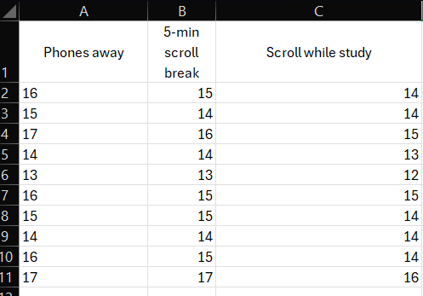
Method for Analysis
Repeated-measures ANOVA utilized for within-subject condition comparisons.
Bonferroni-adjusted post-hoc tests planned for pairwise comparisons in case of significant differences.
Notes:
Data were analyzed using repeated-measures ANOVA to identify significant differences in recall performance across the three conditions within participants.
Post-hoc tests (Bonferroni adjustments) conducted if ANOVA results indicated significant differences.

Slide 13
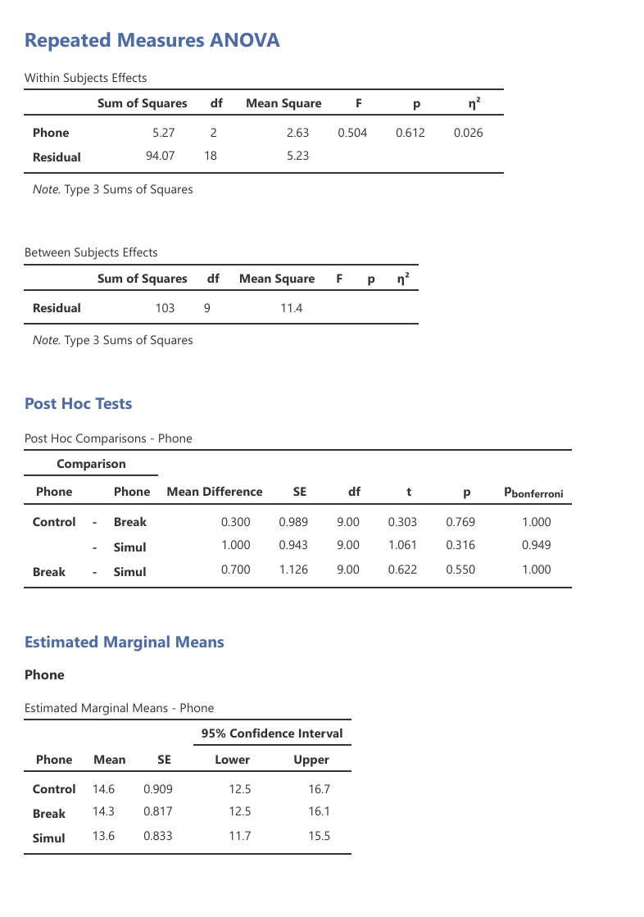
Results from Jamovi
No significant difference found in memory recall across conditions: control (14.6), intermittent distraction (14.3), simultaneous distraction (13.6); p = .612.
Effect sizes minimal (partial η² ≈ .03), suggesting limited immediate cognitive impact from short-form media exposure in controlled conditions​
Notes:
A p-value of .612 (p = .612) indicates a 61.2% probability that the differences in memory recall observed among the conditions occurred purely by chance.

Slide 14
Conclusion
Short-form media’s immediate impact on simple word recall appears minimal in controlled environments, contradicting initial hypotheses from multitasking and cognitive overload literature.
Findings indicate subtle cognitive effects might exist, but further study with rigorous control and larger samples is necessary.
Emphasis on promoting focused, distraction-free studying to maximize academic performance, especially given documented negative impacts from broader media multitasking

Slide 15
Limitaitons
No significant impact likely due to underpowered study (N=10) and simple memory task.
Ceiling effects possibly masked subtle interference effects.
Personalized, uncontrolled media feeds may have reduced cognitive overload compared to standardized stimuli, limiting observed memory impairment​

Slide 16
Implications for students & educators
Although no significant differences were found in immediate recall between the control, intermittent, and simultaneous distraction conditions, these results are meaningful.
They challenge the common assumption that even brief short-form media use during studying always immediately damages memory performance.
This suggests that short-term interactions with short-form media may have a minimal immediate impact on basic memory tasks like simple word recall.
Notes:
Although no significant differences were found in immediate recall between the control, intermittent, and simultaneous distraction conditions, these results are meaningful.
They challenge the common assumption that even brief short-form media use during studying always immediately damages memory performance.
This suggests that short-term interactions with short-form media may have a minimal immediate impact on basic memory tasks like simple word recall.
However, because my study focused only on immediate recall, future research should investigate whether these findings hold true for delayed recall, comprehension, or higher-order academic tasks.

Slide 17
Future Possible Research
Larger, randomized sample sizes (40-60 participants) for generalizability and detecting smaller effects.
Inclusion of delayed recall and higher-order comprehension tasks to capture more subtle cognitive effects.
Compare the stimuli between personalized v.s. standardized

Slide 18
Thank You
For your attention

Slide 19
References
Cain, M. S., Leonard, J. A., Gabrieli, J. D. E., & Finn, A. S. (2016). Media multitasking in adolescence. Psychonomic Bulletin & Review, 23(6), 1932-1941. https://doi.org/10.3758/s13423-016-1036-3 ​s13423-016-1036-3
Chiossi, F., Haliburton, L., Ou, C., Butz, A., & Schmidt, A. (2023). Short-form videos degrade our capacity to retain intentions: Effect of context switching on prospective memory. In Proceedings of the 2023 CHI Conference on Human Factors in Computing Systems (pp. 1-14). Association for Computing Machinery. https://doi.org/10.1145/3544548.3580778
Gavett, B. E., & Horwitz, J. E. (2011). Immediate list recall as a measure of short-term episodic memory: Insights from the serial position effect and item response theory. Archives of Clinical Neuropsychology, 27(2), 125-135. https://doi.org/10.1093/arclin/acr104
The jamovi project. (2023). jamovi (Version 2.3) [Computer Software]. https://www.jamovi.org
Madore, K. P., Khazenzon, A. M., Backes, C. W., Jiang, J., Uncapher, M. R., Norcia, A. M., & Wagner, A. D. (2020). Memory failure predicted by attention lapsing and media multitasking. Nature, 587(7833), 87-92. https://doi.org/10.1038/s41586-020-2870-z ​
Mendoza, J. S., Pody, B. C., Lee, S., Kim, M., & McDonough, I. M. (2018). The effect of cellphones on attention and learning: The influences of time, distraction, and nomophobia. Computers in Human Behavior, 86, 52-60. https://doi.org/10.1016/j.chb.2018.04.027 ​
Nelson, K., & Miller, P. (2020). The impact of social media on the short-term memory of teenagers. Baylor Scientia, 19, 30-37. Embedded in Scientia 2020 Annual Issue. https://issuu.com/baylor_scientia/docs/scientia_2020/s/10467650 ​
Ophir, E., Nass, C., & Wagner, A. D. (2009). Cognitive control in media multitaskers. Proceedings of the National Academy of Sciences, 106(37), 15583-15587. https://doi.org/10.1073/pnas.0903620106
Pellegrino, A., Stasi, A., & Bhatiasevi, V. (2022). Research trends in social media addiction and problematic social media use: A bibliometric analysis. Frontiers in Psychiatry, 13, Article 1017506. https://doi.org/10.3389/fpsyt.2022.1017506
Sharifian, N., & Zahodne, L. B. (2020). Daily associations between social media use and memory failures: The mediating role of negative affect. The Journal of General Psychology, 147(4), 363-390. https://doi.org/10.1080/00221309.2020.1743228
Uncapher, M. R., Thieu, M. K., & Wagner, A. D. (2015). Media multitasking and memory: Differences in working memory and long-term memory. Psychonomic Bulletin & Review, 22(6), 1274-1281. https://doi.org/10.3758/s13423-015-0907-3 ​
Zheng, M. (2021). Influence of short video watching behaviors on visual short-term memory. In Proceedings of the 2021 4th International Conference on Humanities Education and Social Sciences (ICHESS 2021) (pp. 1855-1860). Atlantis Press. https://doi.org/10.2991/assehr.k.211220.318 (Paper ID 125967102)
Zureick, A. H., Burk-Rafel, J., Purkiss, J. A., & Hortsch, M. (2017). The interrupted learner: How distractions during live and video lectures influence learning outcomes. Anatomical Sciences Education, 10(4), 408-417. https://doi.org/10.1002/ase.1754

